Slide 1
Crop Disease Detection and Advisory Systems
Madhu Sudhan C -1RUA24CSE0234
Ponnu Krishna M.P-1RUA24CSE0301
Naga Sai Karthik-1RUA24CSE0050
N. A. Harshal-1RUA24CSE0269
RV University
Bengaluru India

Slide 2
Problem Statement
Lack of Early Disease Detection: Farmers often fail to identify plant diseases at an early stage due to limited technical knowledge and visual similarity between diseases.
Overuse and Misuse of Pesticides: Farmers often apply broad-spectrum pesticides unnecessarily, leading to increased production costs, soil degradation, and environmental pollution.
Lack of Real-Time Decision Support: Farmers do not have access to instant, data-driven recommendations regarding disease severity, climate risk, and crop suitability during critical farming stages.
Absence of Crop Suitability Guidance: Farmers often choose crops without analyzing soil pH and environmental compatibility. This reduces productivity and increases the risk of disease occurrence.
No Unified Platform for Image + Climate + Risk Analysis: There is no integrated AI system that combines image-based disease detection with climate risk scoring and suitability indexing.

Slide 3
Dataset(s) details
Dataset: PlantVillage Color Leaf Dataset
Training: 80% of images
Testing: 20%
Number of Classes: 10 distinct disease
Link:- https://github.com/spMohanty/PlantVillage-Dataset/tree/master/raw/color

Slide 4
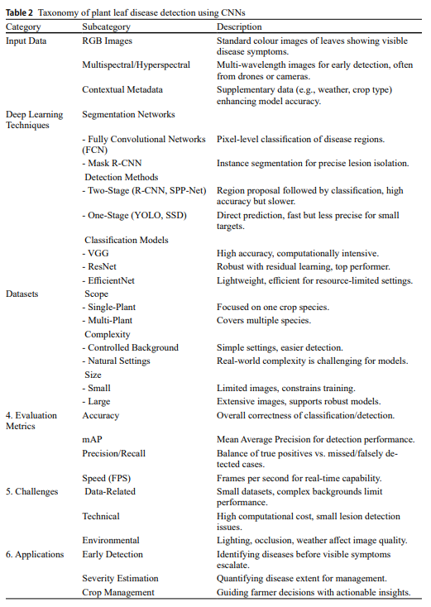
Literature Survey
1. “Plant leaf disease detection and classification using convolution neural networks model”- Tanko Daniel Salka, Marsyita Binti Hanafi,
Sharifah M. Syed Ahmad Abdul Rahman, Dzarifah Binti
Mohamed Zulperi, Zaid Omar (Springer Nature (2025))
Methods: Comparative CNN analysis, transfer learning evaluation.
Datasets: PlantVillage, ImageNet, custom field datasets.
Paper link: https://link.springer.com/article/10.1007/s10462-025-11234-6

Slide 5
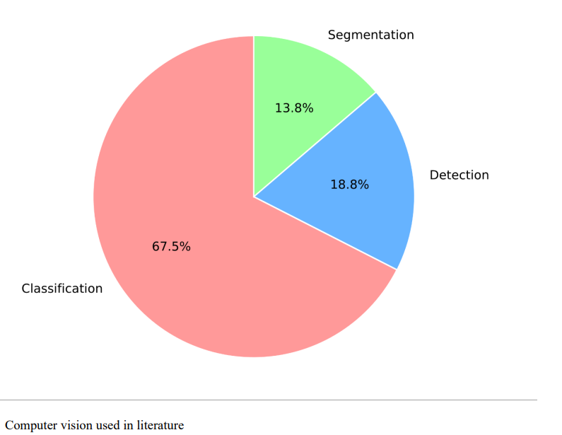
Literature Survey Contd.
2. “A systematic review of deep learning techniques for plant diseases”- Ishak Pacal, Ismail Kunduracioglu, Mehmet Hakki Alma, Muhammet Deveci, Seifedine Kadry, Jan Nedoma, Vlastimil Slany,Radek Martinek (Springer Nature (2024))
Methods: Classification, Detection, Segmentation
model comparison.
Datasets: PlantVillage, ImageNet, Multi-crop datasets.
Paper link: https://link.springer.com/article/10.1007/s10462-024-10944-7

Slide 6
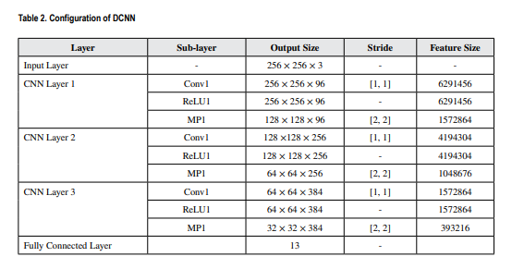
Literature Survey Contd.
3. “Multi-Class Plant Leaf Disease Detection Using a Deep Convolutional Neural Network”- Shriya Jadhav, Anisha M. Lal (IGI Global (2022))
Models: Deep Convolutional Neural Network (CNN).
Datasets : PlantVillage, Field-collected leaf images.
Paper link: https://www.igi-global.com/gateway/article/315126

Slide 7
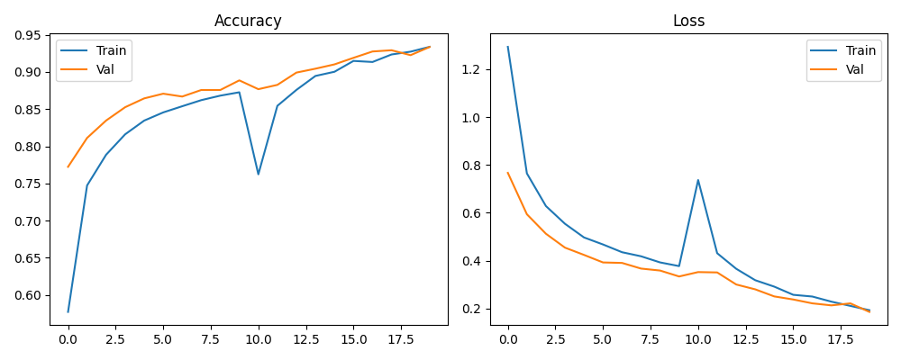
Preliminary Results
https://arxiv.org/pdf/2102.00160

Slide 8
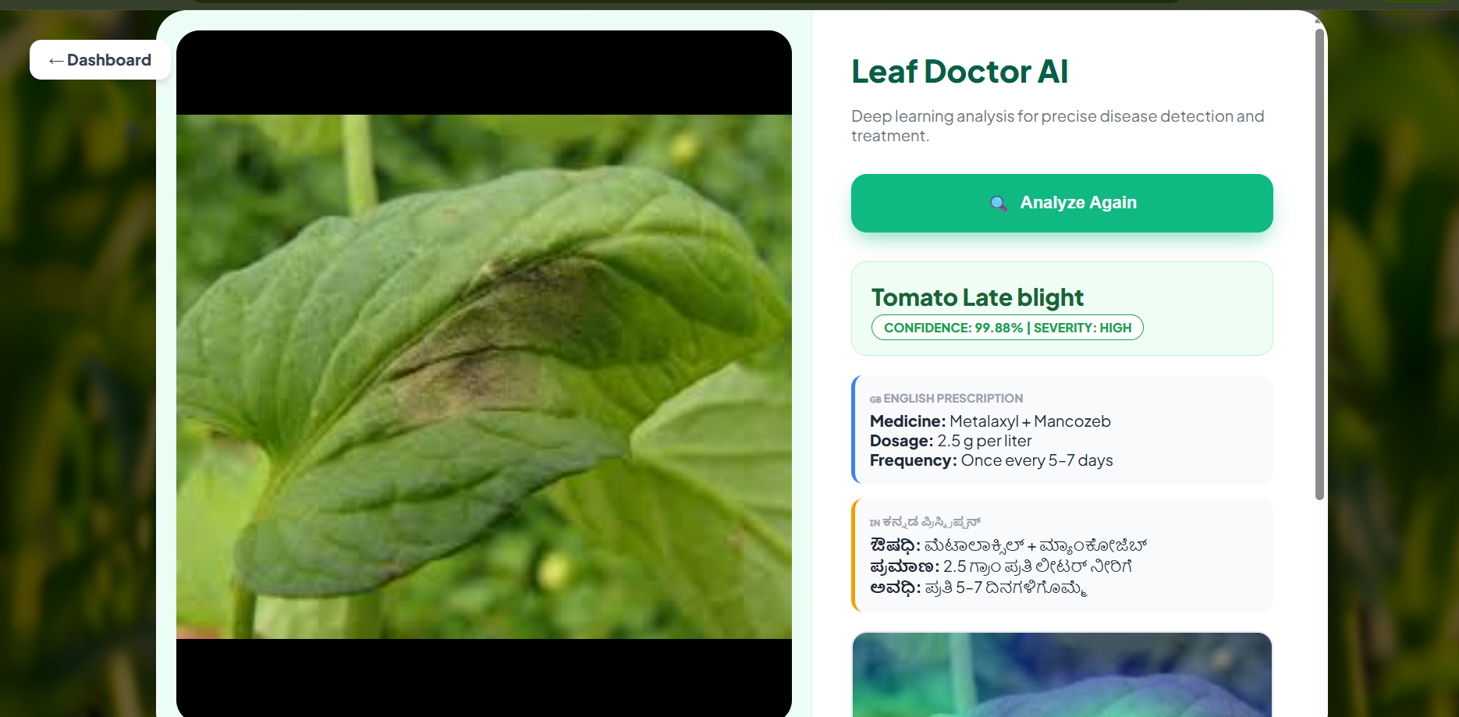
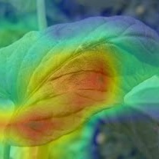
Preliminary Results

Slide 9
Further Plan
Provide treatment recommendations and pesticide guidance in regional languages.
Collect more field images under varying lighting and backgrounds.
Include more crops and rare disease classes.
Improve model generalization and reduce misclassification.
Detect multiple disease spots in the same image.

Slide 10
Thank you

